Slide 1

Command Line Arguments & File I/O in C

Slide 2
C command line argument
When we run a program, we’ll often need to supply it with information.
This may include a file name or a parameter that modifies the program’s behavior.
Command-line arguments are called program parameters in the C standard.

Slide 3
C command line argument
To obtain access to command-line arguments, main must have two parameters:
int main(int argc, char *argv[])
{
…
}
argc (“argument count”) is the number of command-line arguments.
argv (“argument vector”) is an array of pointers to the command-line arguments (stored as strings).

Slide 4
C command line argument
argv[0] points to the name of the program, while argv[1] through argv[argc-1] point to the remaining command-line arguments.
argv[argc] is always a null pointer—a special pointer that points to nothing.
The macro NULL represents a null pointer.

Slide 5
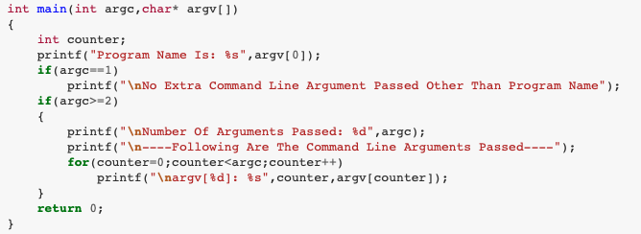
C command line argument

Slide 6
C command line argument
$ ./a.out
Program Name Is: ./a.out
No Extra Command Line Argument Passed Other Than Program Name
$ ./a.out First Second Third
Program Name Is: ./a.out
Number Of Arguments Passed: 4
----Following Are The Command Line Arguments Passed----
argv[0]: ./a.out
argv[1]: First
argv[2]: Second
argv[3]: Third

